Slide 1
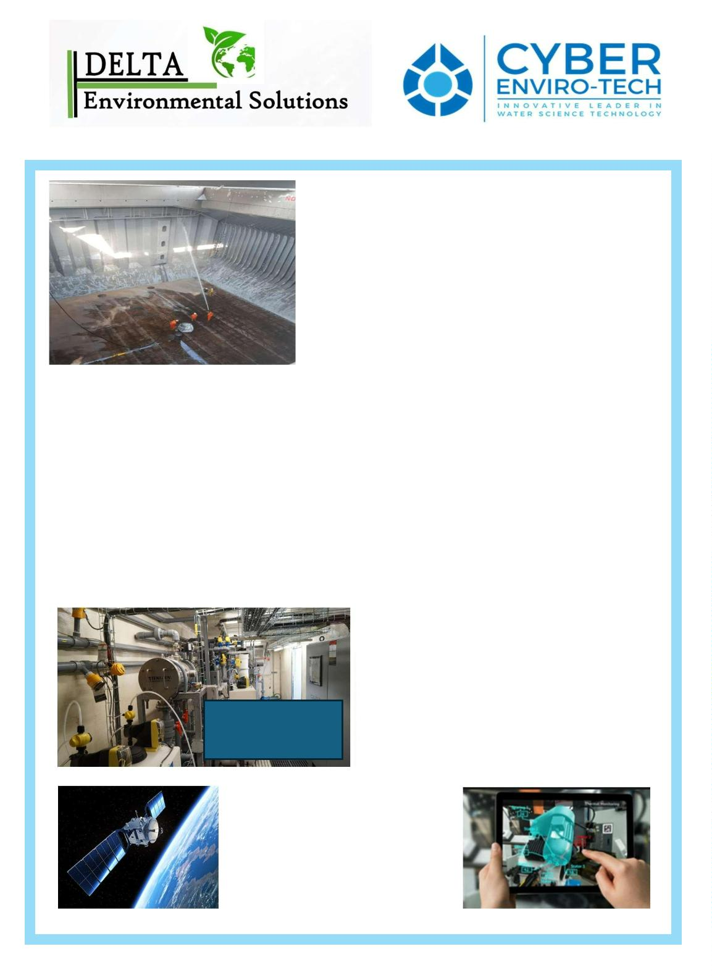
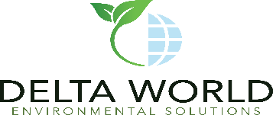
Marine Cleaning Option
Environmentally Safe
MARINE SOLUTIONS
POTABLE WATER – A DELTA SOLUTION
Water Disinfection for Potable Use for Humans
• Complete site layout with specifications on piping/valves
• Volumetric levels expected for daily treatment results
• Type of Pumps in use for transport of water in/out
• Access Points for Equipment Placement to Storage Tanks
• Status of Bacterial Content in holding tanks and feed lines
• Analysis of trace contaminants for potential pretreatment [heavy metals – chemical residual etc.]
• 5 mile site survey for Civil Engineering impediments [flood zone – landslides – seismic – volcanic etc.]
• Environmental regulations and compliance for types of Marine Holding Tanks approved [PFAS-Forever Chems]
• Microplastic, nano contaminants, and origination of fluid for WHO outbreaks [viral/nuclear/hydrogen hybrids]
• All functional uses if secondary or tertiary treatments are applicable for safety purposes [lab/pharma/med]
DELTA ENVIRONMENTAL PARAMETERS FOR QUOTATION PROVISION
Each Phase or Stage required is predicated on the correct information provided to Delta Environmental.
• Highest Removal Efficiency / Kill Ratios
• Lowest Energy Consumption
• State of the Art In Bacterial / Virus Removal
• Extended Disinfection for Extended Residual Cycle
• Lowest Environmental Impact / Water Recycling
• Less Remediation Time / Less Chemicals
• Verified 5 log reduction [Texas Tech – Food ]
• Emergency backup mode for catastrophic events
• Modular, scalable, multi-task capable, neural net
DELTA SOLUTIONS
• Customized
• Real time Monitoring
• 4th Generation SCADA
• Machine Learning Algorithms
• Extended Disinfection for Extended HRT
• Fault Diagnostics
• Report Generation
• Maintenance Simplification

