Slide 1
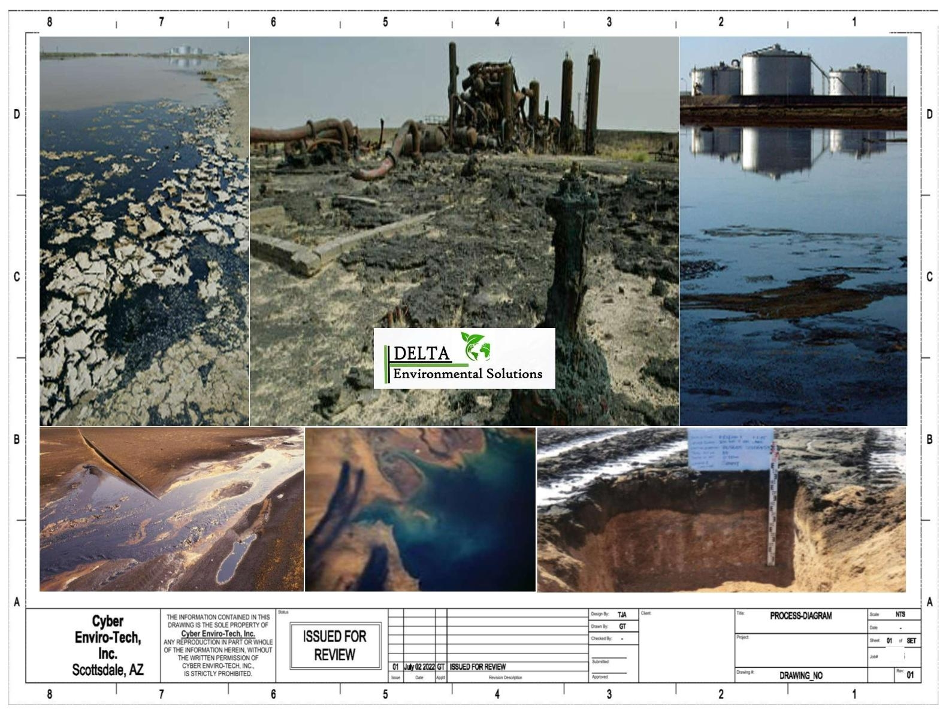

SLUDGE RECOVERY
Site Selection plays a prominent role in which
process is used for remediation. The figure to the
bottom right highlights a low TPH [Total Petroleum
Hydrocarbon ] level with a limited topsoil level more
suitable to soil remediation. Our model shown in this
package is geared more to highest petroleum sludge
TPH with the highest potential for groundwater
contamination.
Sludge Lakes
Sludge Ponds
Refineries 2024
Mobile Sludge Plant

Slide 2
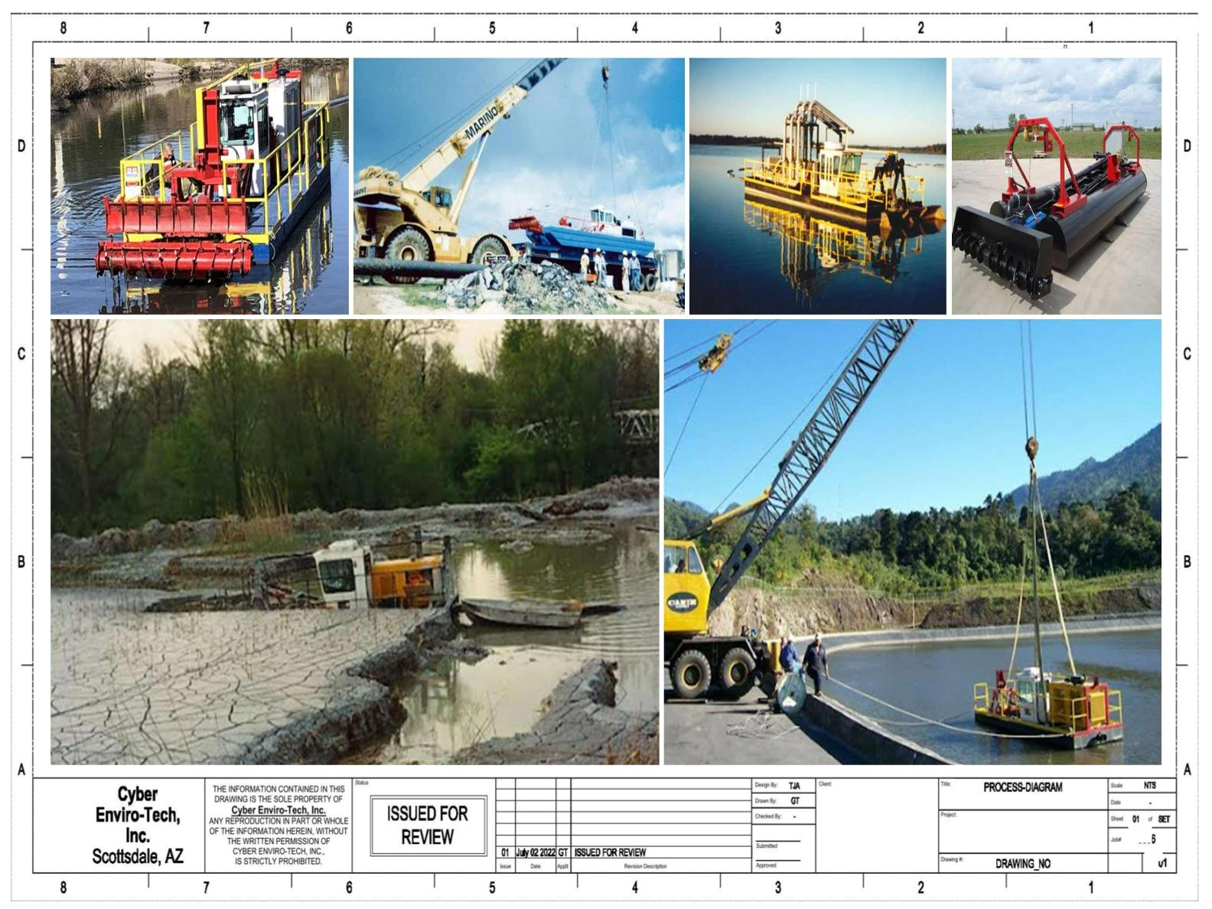

Site Selection: the higher TPH comes in a diverse series of
settings that directly impact recovery costs like the “hard
cap” shown directly below. Up to 80% of the costs for access
to our processes can be tied up into accessing the
remediation site.
Sludge Lakes
Sludge Ponds
Refineries 2024
Mobile Sludge Plant

Slide 3
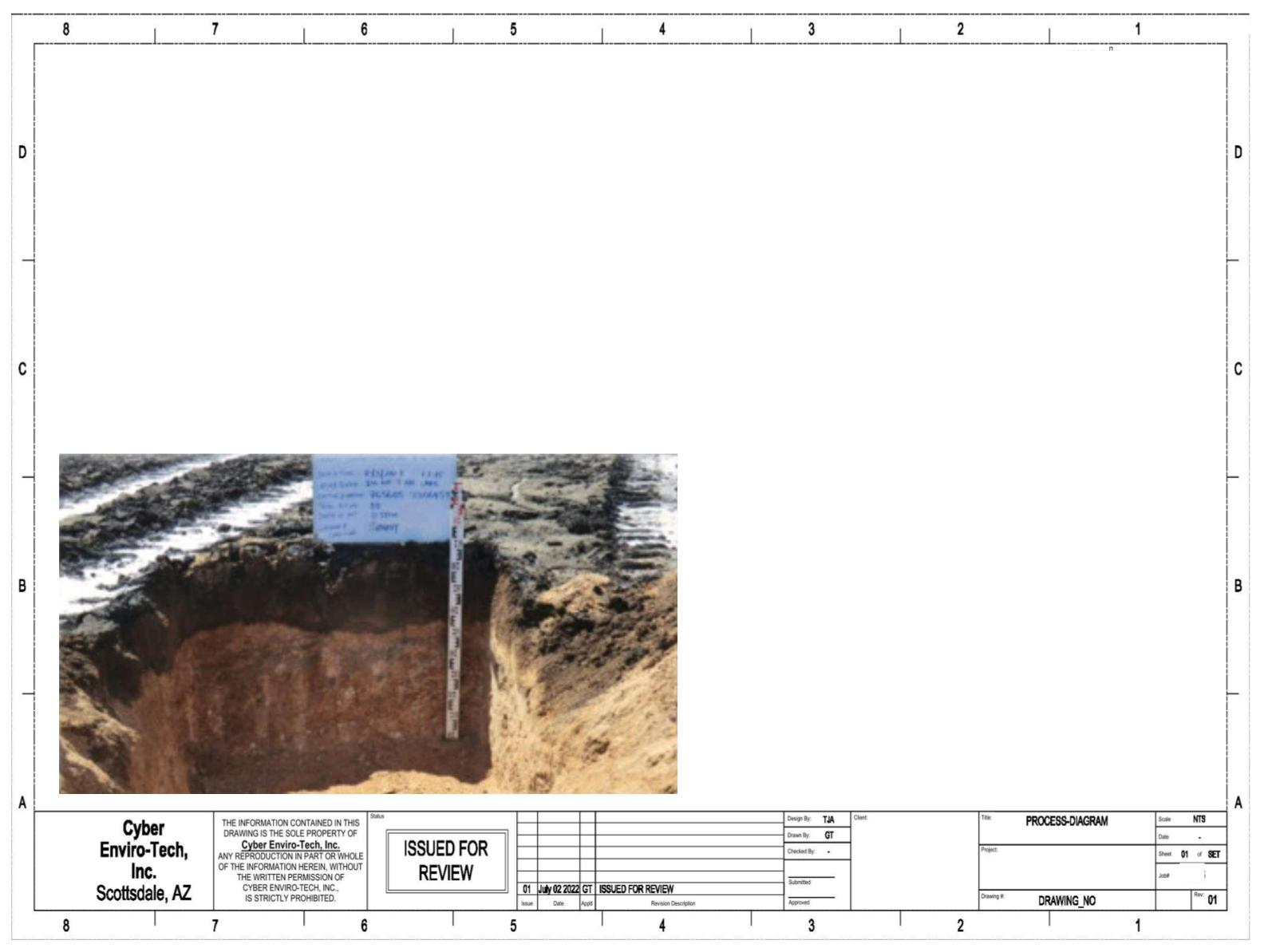

NOTE:
Based on numerous evaluation papers detailing the current state of
dehydration of oil lakes and ponds resident in desert conditions,
this particular recovery method strictly applies to either deep lakes
with higher TPH levels or refinery slop recently deposited for TPH
recovery.
The absence of short-chain hydrocarbons in most of the investigated locations
suggests that emission of volatile hydrocarbons dominated transport processes in the
investigated area. This can be attributed to the desert climate conditions which, on
one hand, favour (due to low relative humidity and high temperature) volatilization of
these lighter hydrocarbon species with low vapor pressure and, on the other, disfavor
their downward migration (due to a lack of rainfall). Under such conditions, the
heavier component (after partitioning of the volatile portion) migrated through the
soil column under the force of gravity. Because of their low mobility and large
molecular size that could be easily trapped in soil pores, the downward moment of
these long-chain hydrocarbons tended to be slower, as compared to the low-
molecular-weight petroleum hydrocarbons. After the oil lake completely dried out, it
The system outlined reflects a unique means of extraction of
recoverable TPH without the limitations of centrifugal tri-bi canters. is unlikely that any further downward migration of hydrocarbons by force of gravity
One core consideration is the structural limitations under the soil
column which favors long chain hydrocarbons with higher
molecular weight. Lighter TPH has vaporized under shallow
conditions which is why we recommend testing prior to positioning
this process for the maximum efficiency.
will take place.
The extremely variable TPH among the different sampling location is probably
attributable to the thickness of the overlying crude oil layer that was controlled by
the surface elevation. Although the soils were generally of coarse texture, the
connectivity of soil pores was likely to be poor due to the presence of secondary
minerals such as gypsum and carbonates, which could block soil pores. This may be
another reason for the impeded vertical migration of the spilled oil.
ELSEVIER – SCIENCE DIRECT – KUWAIT 2023
Sludge Lakes
Sludge Ponds
Refineries 2024
Mobile Sludge Plant

Slide 4
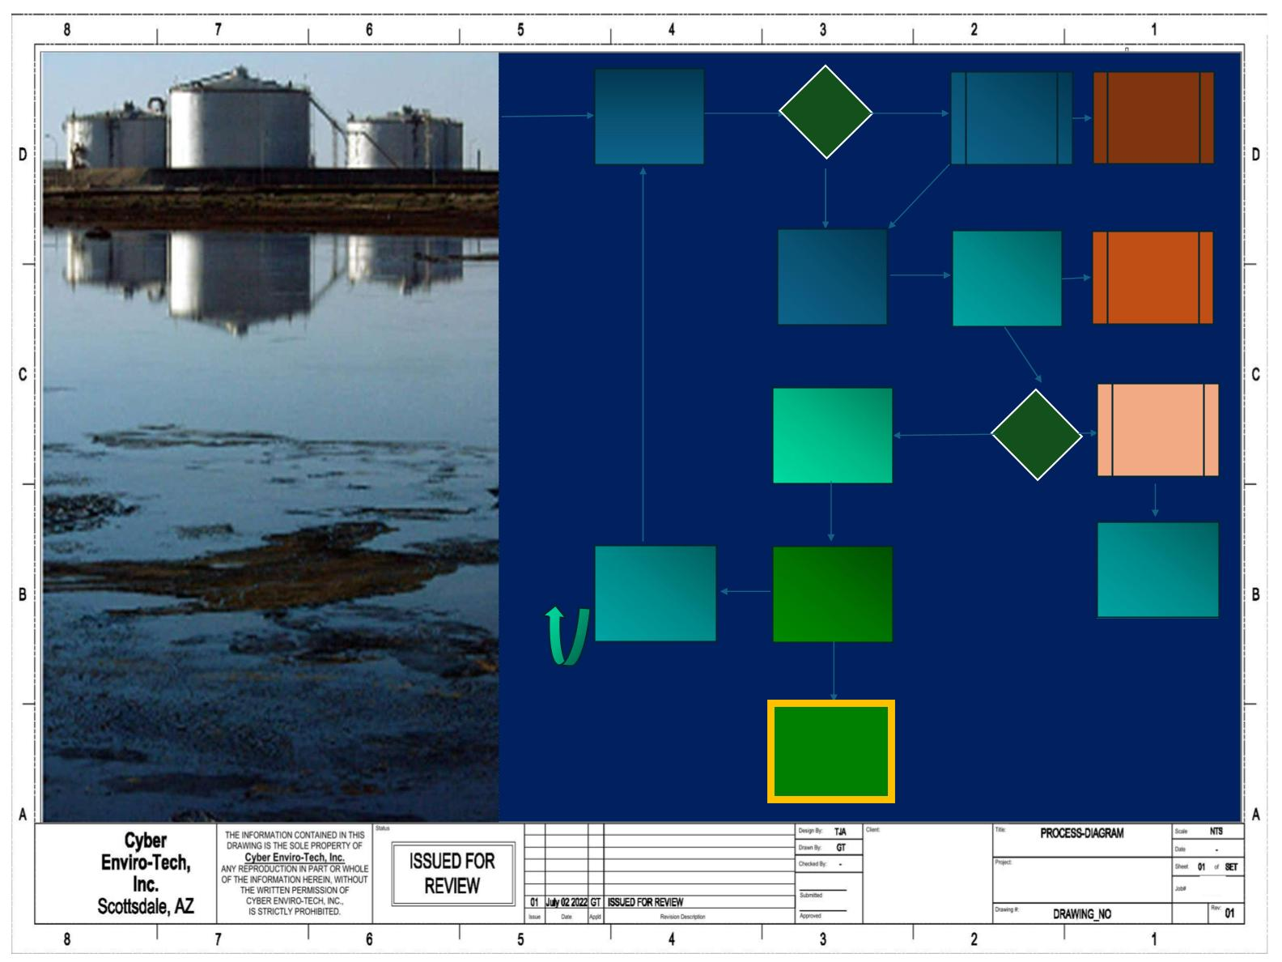

Re-Hydration
Remediation
Heavy
Solid
Removal
Solids
High
Low
Secondary
Filtration
Medium
Solid
Removal
Slate Shaker
High
Light Solid
Removal
Demulsification
TPH %
Extraction of Sludge
Low
IT’S A WASTE
TO WASTE
YOUR WASTE
Post
Process
Recycle
Clean Water
Separation
Clean Crude
Refinery
Ready
Sludge Lakes
Sludge Ponds
Refineries 2024
Mobile Sludge Plant

Slide 5
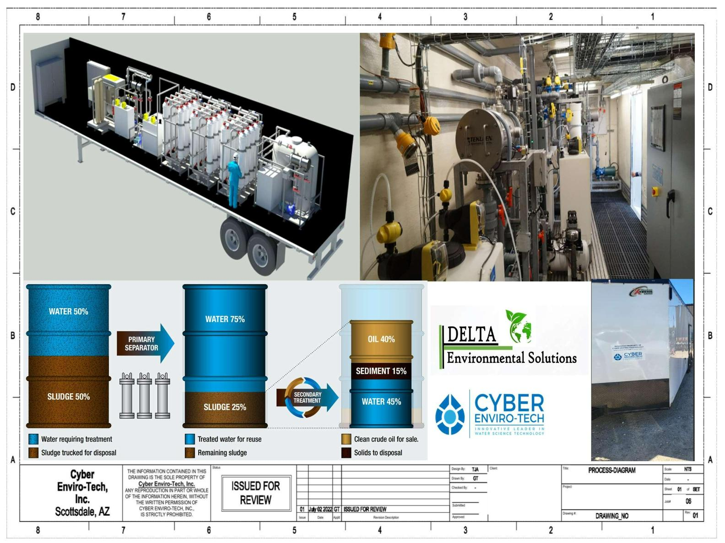

Sludge Lakes
Sludge Ponds
Refineries 2024
Mobile Sludge Plant

